Slide 1
Customer Retention Blog study
Neha Shaharwale

Slide 2

Abstract of the Model
Customer churn will cause the value flowing from customers to enterprises to decrease. If customer churn continues to occur, the enterprise will gradually lose its competitive advantage.
The results of this analysis can better serve the practice of customer relationship management in E – retails success factor

Slide 3
Introduction of the Analysis
Loyal customers play an important role in improving business performance and can promote the core competitiveness of enterprises
They can increase the opportunity and time for enterprises to obtain basic profits and help enterprises obtain premium income, consolidate market position, reduce market risks.
For every 5% increase in customer retention rate, the net present value of customers in the business environment will increase by 25% to 95%

Slide 4

Research Hypotheses
The reasons for customer churn may be different.
We considered some churns in the given Data set.
Longer time to get logged in
Longer time in displaying graphics and photos
Late declaration of price
Longer page loading time
Limited mode of payment
on most products
Longer delivery period
Frequent disruption when moving.
Website is as efficient as before

Slide 5
Data and Variables
Before customer churn, to accurately identify the cause of churn is the key to winning customers back and terminating this factor to result in customer churn again.
Customer churn is an important content of customer relationship management
If we consider the variables and data responsible for Churn may reduce its contents for better customer satisfaction.

Slide 6

Data Sources
When making decisions about customers and dealing with customer churn, customer value is an important criterion that needs to be considered.
We have added this data set which will help us to consider the churn variables.

Slide 7
Problem Statement
Customer retention refers to the actions and strategies a business uses to try and keep existing customers. To enable these actions, customer retention analytics provide predictive metrics of which customers might churn — which enables them to get ahead of it.
Here the data is collected from the Indian online shoppers. Results indicate the e-retail success factors, which are very much critical for customer satisfaction.
Some important key aspects in the case study .
Customer Retention :
Your company’s retention rate is a measurement of customers who return to your brand to purchase more products or continue using your services.
For example, it would measure the number of customers who continued to resubscribe to your service month after month. However, it is less important for companies selling cars, furniture, or other items that are not replaced frequently.
Customer Churn :
Customer churn refers to customers who discontinue their business with your brand. This can happen for a variety of reasons. It can mean the customer was dissatisfied with your product or service or that they decided to discontinue service because it was no longer needed or affordable.

Slide 8
Causes for Customer Churn
1.Poor customer service experience
2.Decreased quality of products or services 3.Additional benefits, features, or functionalities found elsewhere
4.Price differences with competitors
5.Your product is no longer convenient
6.Customer’s budget or schedule changed
7.Promotional period ended

Slide 9


Exploratory Data Analysis (EDA) Steps
To do Exploratory Data Analysis in Python, we
need some python libraries such as
numpy, pandas, and seaborn.

Slide 10



1. Check data shape (num of Rows & Columns)
Output :

Slide 11
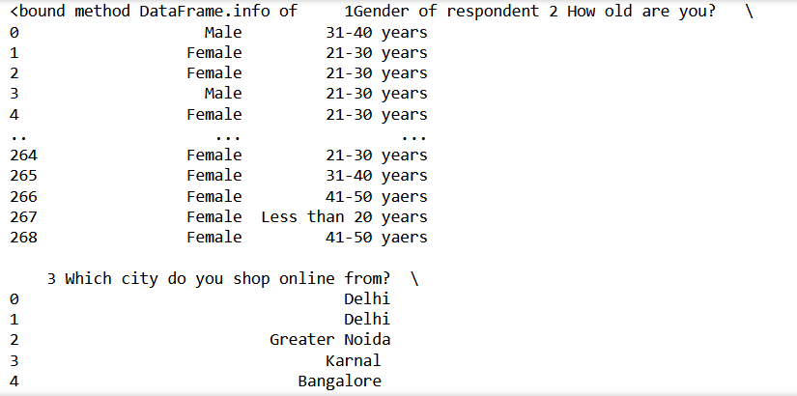
2. Check each data type of columns and missing values
Output :

Slide 12

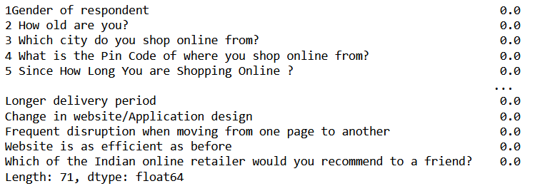
3. Check the percentages of missing value
Output :

Slide 13


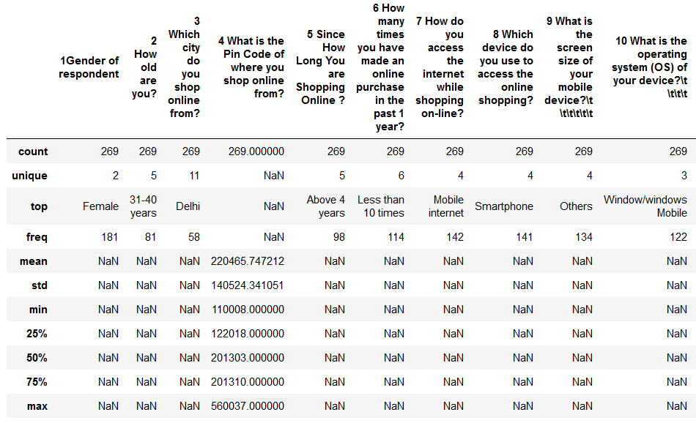
4. Summary Statistics
Output :

Slide 14
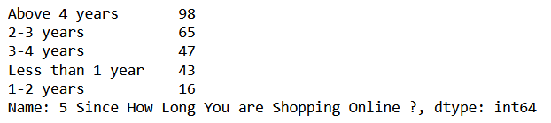
5. Check value counts for a specific column
Output :

Slide 15
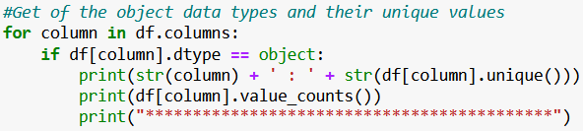
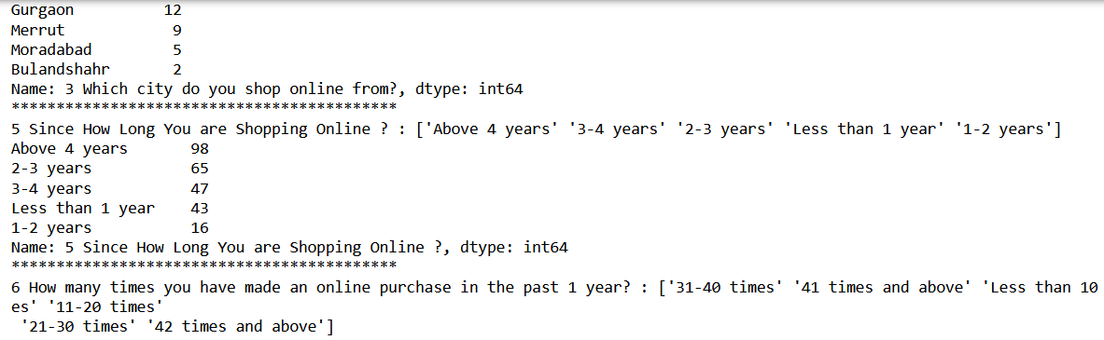
6.Get of the object data types and their unique values
Output :

Slide 16

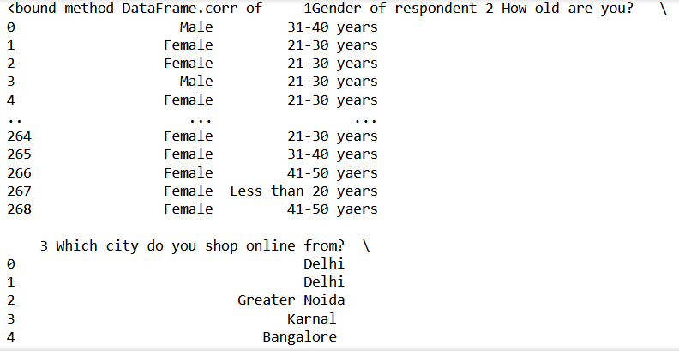
7.Check the correlation between variables in the data
Output :

Slide 17
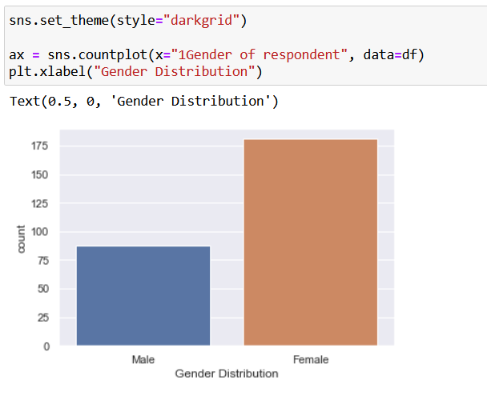
Visualization – Gender Distribution

Slide 18
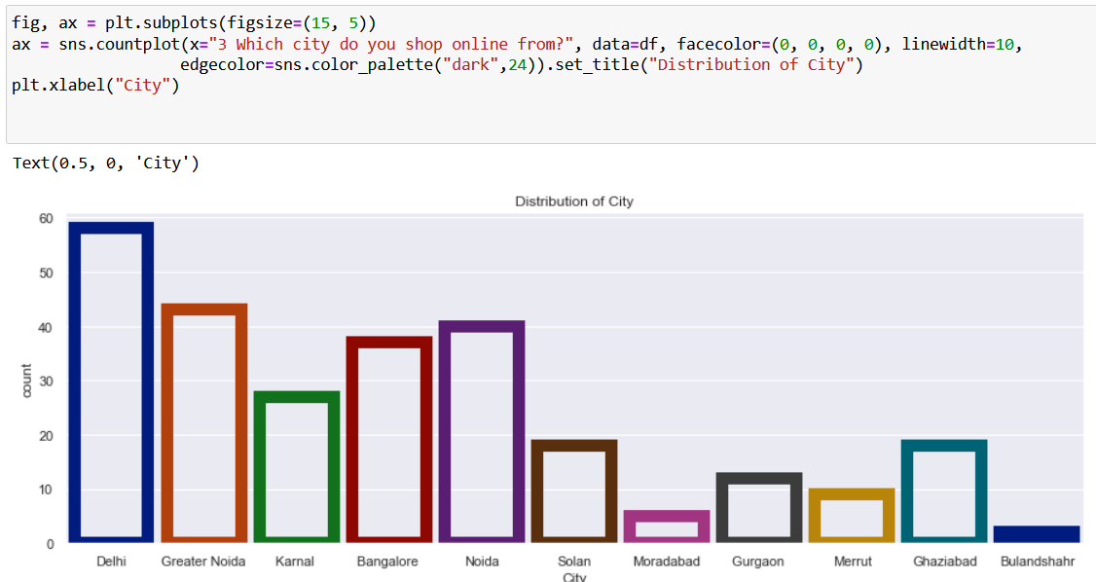
Visualization-Distribution of City

Slide 19
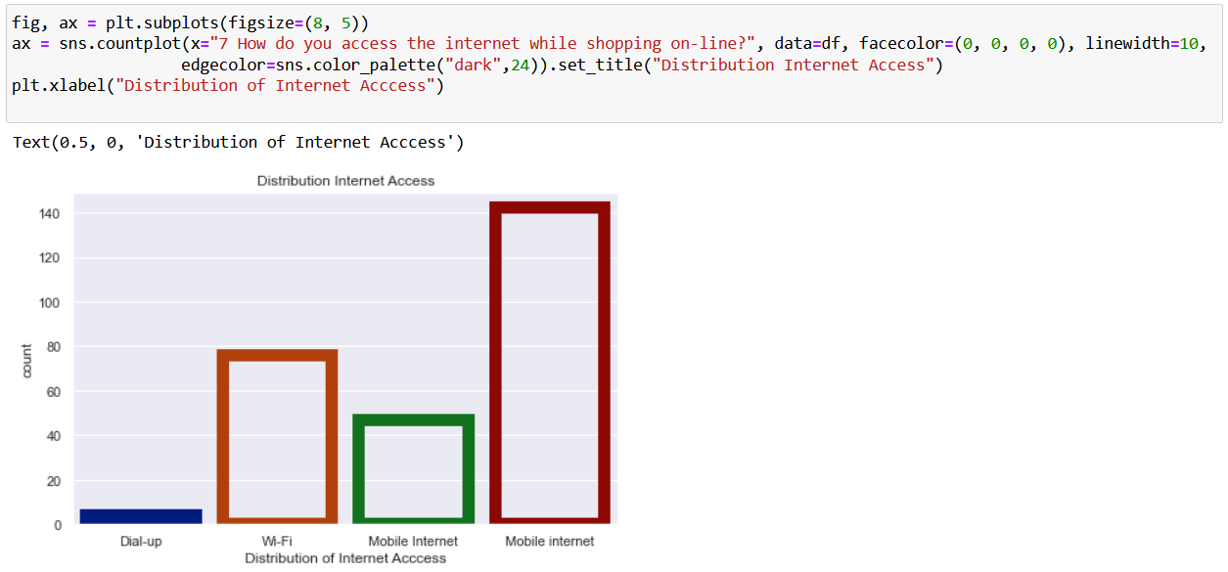
Visualization- Internet Access Distribution

Slide 20
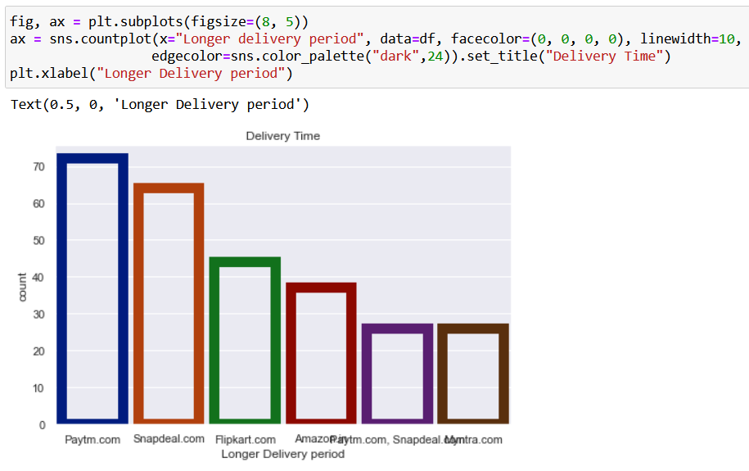
Visualization- Delivery Distribution

Slide 21
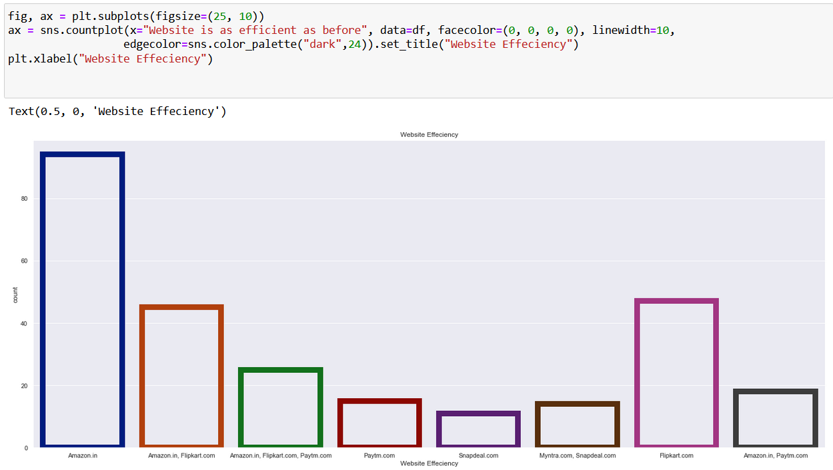
Visualization-Website efficiency

Slide 22
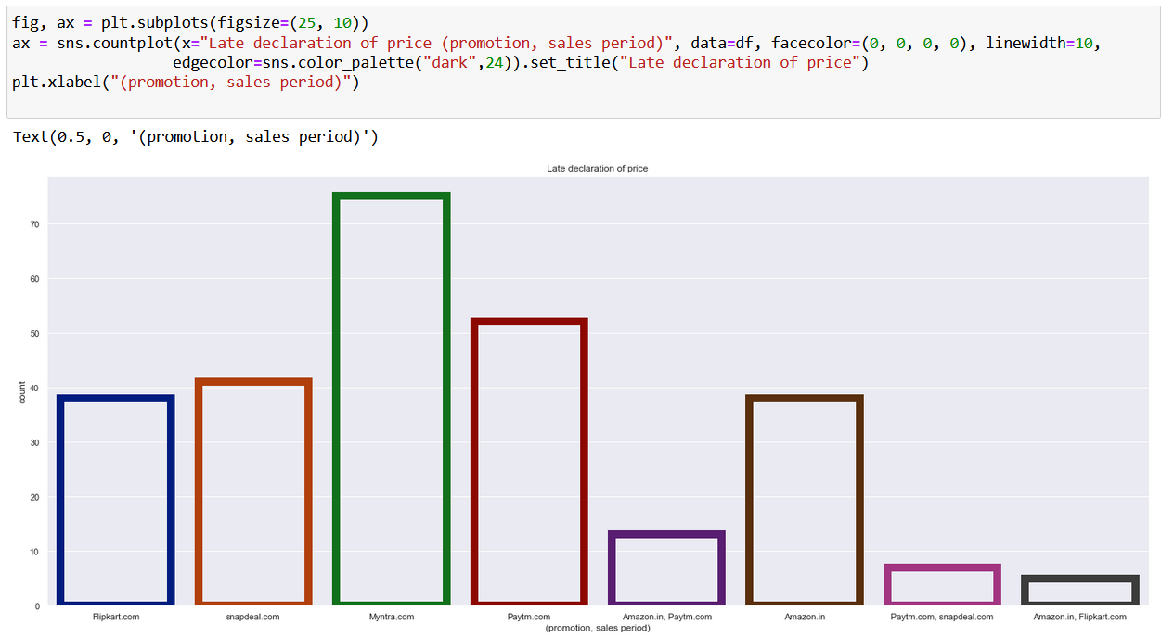
Visualization

Slide 23
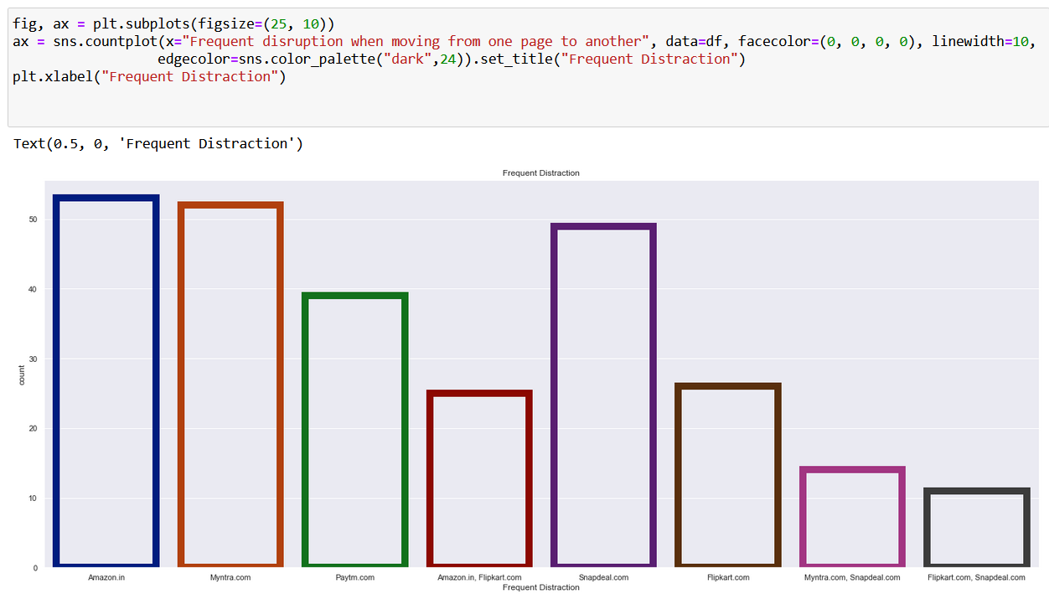
Visualization-frequent distraction

Slide 24
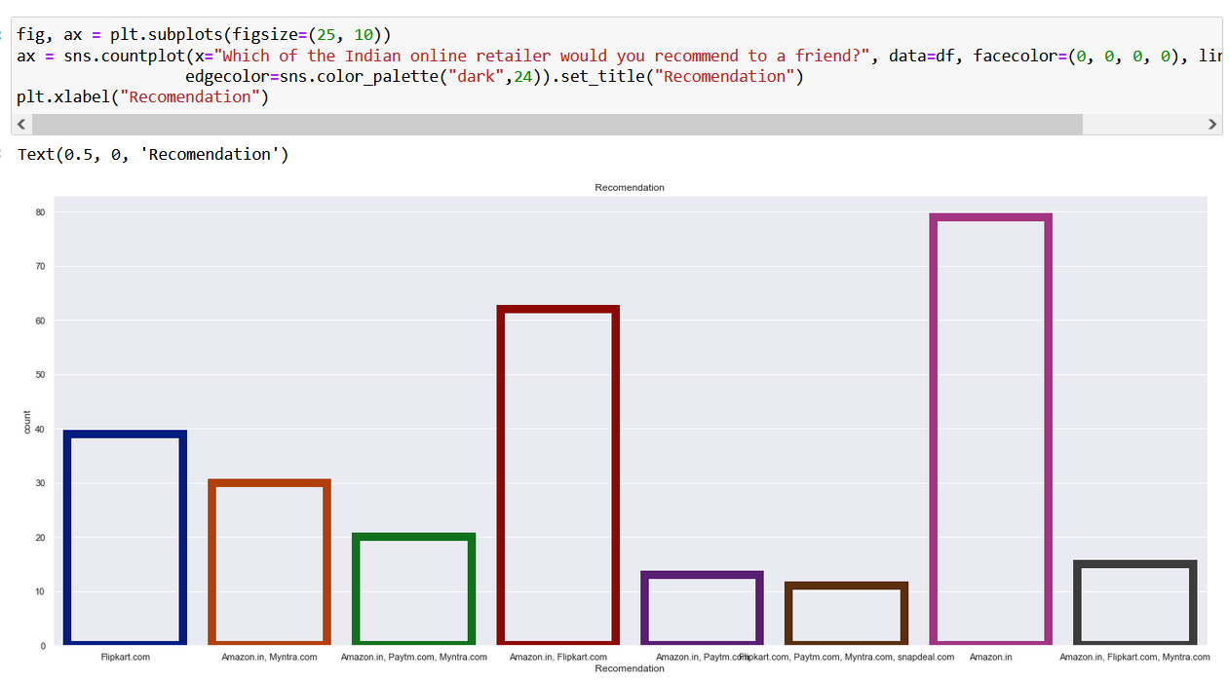
Visualization-Recommendation

Slide 25
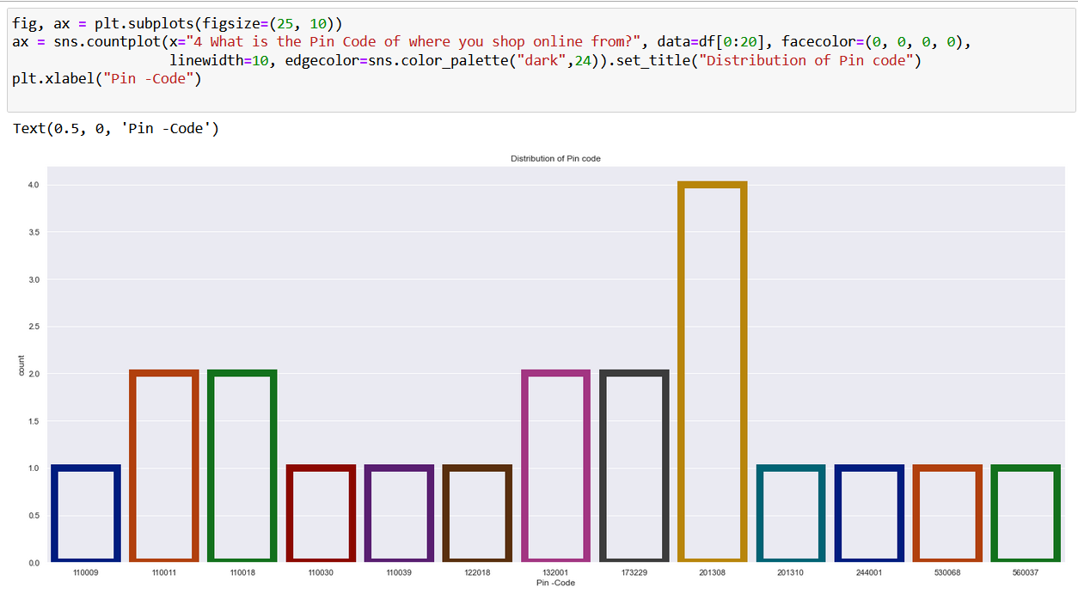
Visualization

Slide 26

Conclusion
Female gender are the highest for the transaction
Delhi City is at the highest level to for Online retailing.
People use Mobile Internet more than any other Internet access to carry out the Online activity.
Amazon is at the top level as per website efficiency.
Paytm is at highest level which is late for the Delivery.
Myntra and Amazon are at same level which causes delay in Website switching.
As per the analysis people recommend Amazon more than any other for Online retailing
Pin code – 201308 is the sector where there are highest Online retailing.

